Slide 1
Project : Robust QA
2023126703 Junseo Park

Slide 2
Table of Contents
Objective
Introduction
Method
Experimental result
Conclusion

Slide 3
Objective
“Build robust QA model by fine-tuning pre-trained DistilBERT on the out-of-domain dataset”

Slide 4
Introduction
1. Fine-tune DistilBert for In-domain dataset
2. Evaluation on out of domain with DistilBert
In-domain train: 242,304 (SQuAD, NewsQA, Natural Questions)
In-domain validation: 38,888 (SQuAD, NewsQA, Natural Questions)
Out of domain dataset: 721 (DuoRC, RACE, RelationExtraction)

Slide 5
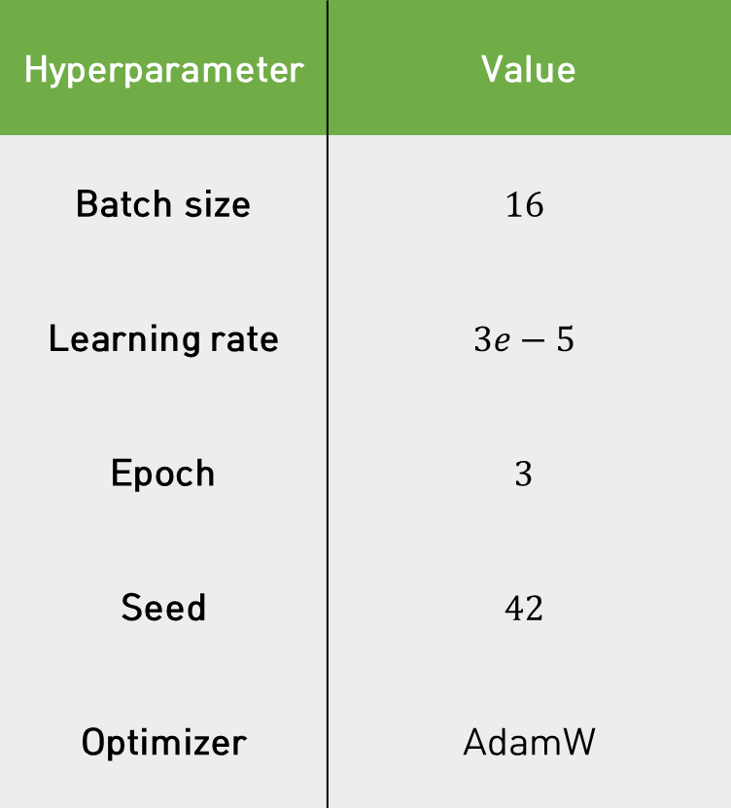
Baseline
Hyperparameter | Value
Batch size | $$16$$
Learning rate | $$3e−5$$
Epoch | $$3$$
Seed | $$42$$
Optimizer | AdamW
 | F1 score | Exact Match
Validation | 70.31 | 54.16
Evaluation | 48.41 | 31.94

Slide 6

Proposed method
Data augmentation: EDA
AutoML: Control hyper-parameter
Start
Pre-trained DistilBERT
<Base>
Data
End
<Add method>
Augmentation
Hyperparameter
Training

Slide 7
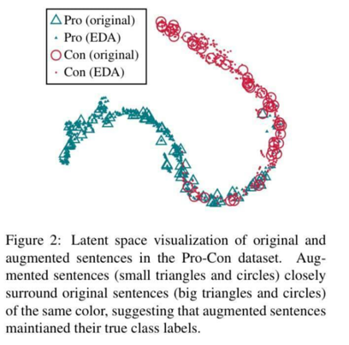
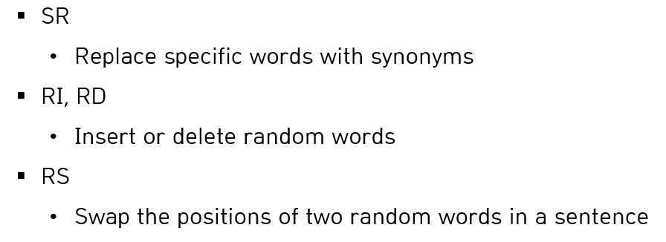
Proposed method
Data augmentation
EDA(Easy data augmentation)

Slide 8
Proposed method
EDA
Augmentation for all train datasets
The university is the major seat of the Congregation of Holy Cross (albeit not its official headquarters, which are in Rome). Its main seminary, Moreau Seminary, is located on the campus across St. Joseph lake from the Main Building.
answer_start: 675
EDA
The university is the major seat of the Congregation Holy (albeit official headquarters, which are in Rome). Its main Moreau Seminary, is located on the campus across St. Joseph lake from the Building.
answer_start: 606

Slide 9
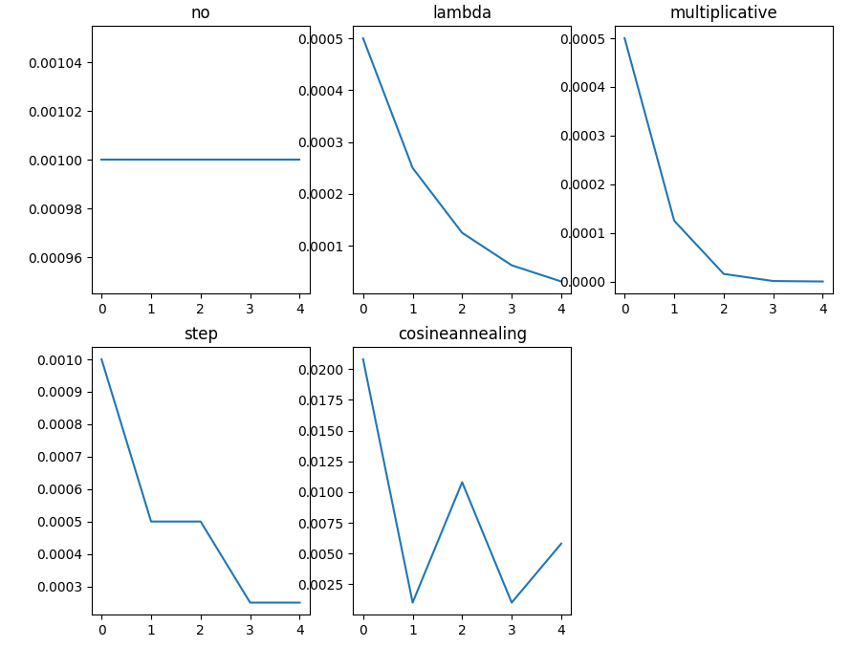
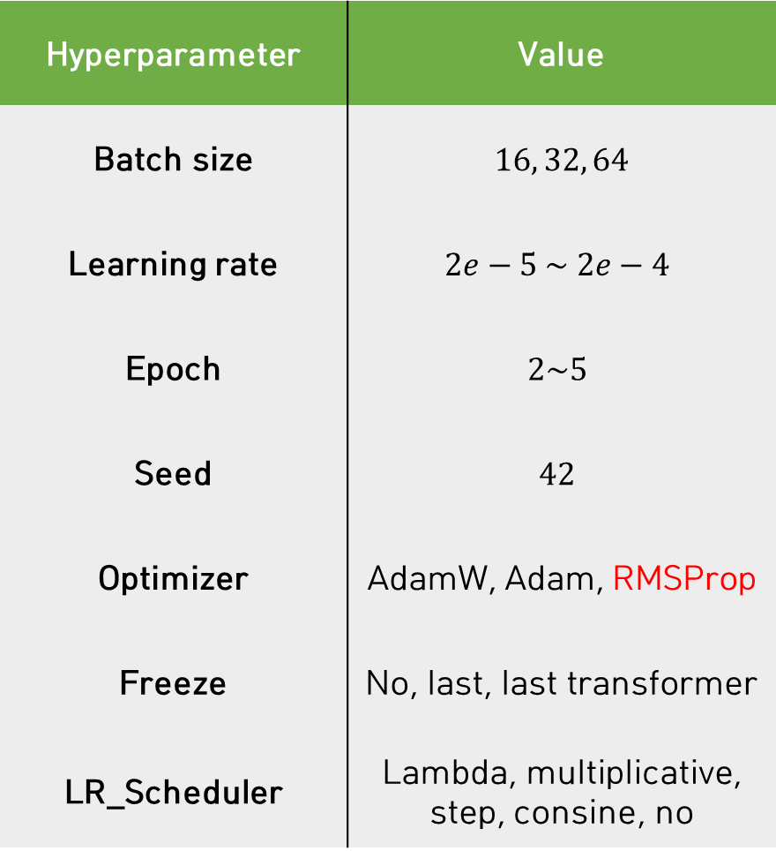
Proposed method
Hyperparameter | Value
Batch size | $16, 32, 64$
Learning rate | $$2e−5 \sim 2e−4$$
Epoch | $$2\sim 5$$
Seed | $$42$$
Optimizer | AdamW, Adam, RMSProp
Freeze | No, last, last transformer
LR_Scheduler | Lambda, multiplicative, step, consine, no
2. AutoML
Hyper-parameter tuning

Slide 10
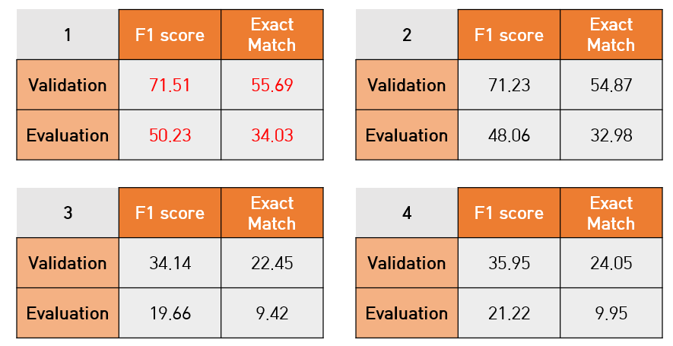
Proposed method
2. AutoML
SGD -> RMSProp
AdamW & Adam
SGD

Slide 11
Experimental result
Only EDA
Only AutoML
EDA + AutoML

Slide 12
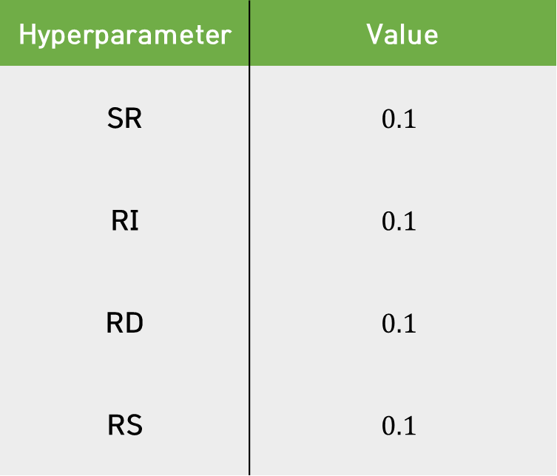
Experimental result: Only EDA
EDA
Train datasets: 242304 -> 418137
Hyperparameter | Value
SR | $$0.1$$
RI | $$0.1$$
RD | $$0.1$$
RS | $$0.1$$
 | F1 score | Exact Match
Validation | 69.95 | 53.85
Evaluation | 47.25 | 32.20

Slide 13

Experimental result: Only EDA
<Baseline>
<EDA>
 | F1 score | Exact Match
Validation | 70.31 | 54.16
Evaluation | 48.41 | 31.94
 | F1 score | Exact Match
Validation | 69.95 | 53.85
Evaluation | 47.25 | 32.20
Add noise and build up robustness
There are more noise than the original

Slide 14
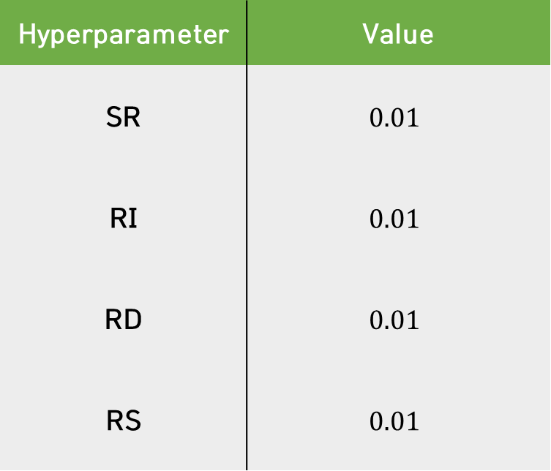
Experimental result: Only EDA
EDA
Train datasets: 242304 -> 473866
Hyperparameter | Value
SR | $$0.01$$
RI | $$0.01$$
RD | $$0.01$$
RS | $$0.01$$
 | F1 score | Exact Match
Validation | 70.23 | 53.97
Evaluation | 50.03 | 35.08

Slide 15
Experimental result: Only EDA
<Baseline>
<EDA>
 | F1 score | Exact Match
Validation | 70.31 | 54.16
Evaluation | 48.41 | 31.94
 | F1 score | Exact Match
Validation | 70.23 | 53.97
Evaluation | 50.03 | 35.08
EDA is works
Add the appropriate noise

Slide 16
Experimental result: Only AutoML
1 | F1 score | Exact Match
Validation | 71.51 | 55.69
Evaluation | 50.23 | 34.03
2 | F1 score | Exact Match
Validation | 71.23 | 54.87
Evaluation | 48.06 | 32.98
3 | F1 score | Exact Match
Validation | 34.14 | 22.45
Evaluation | 19.66 | 9.42
4 | F1 score | Exact Match
Validation | 35.95 | 24.05
Evaluation | 21.22 | 9.95
Trial = 10

Slide 17
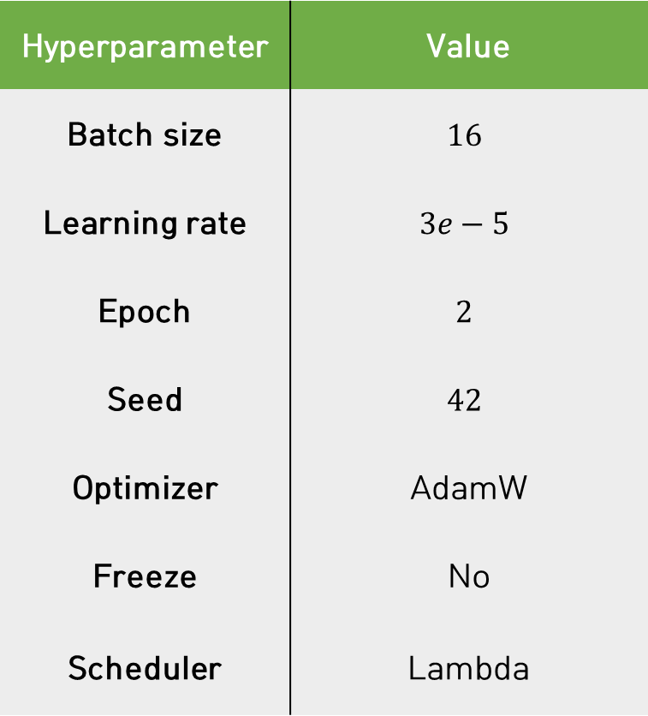
Experimental result: Only AutoML
Best result
Hyperparameter | Value
Batch size | $$16$$
Learning rate | $$3e−5$$
Epoch | $$2$$
Seed | $$42$$
Optimizer | AdamW
Freeze | No
Scheduler | Lambda
1 | F1 score | Exact Match
Validation | 71.51 | 55.69
Evaluation | 50.23 | 34.03

Slide 18
Experimental result: Only AutoML
<Baseline>
<AutoML>
 | F1 score | Exact Match
Validation | 70.31 | 54.16
Evaluation | 48.41 | 31.94
1 | F1 score | Exact Match
Validation | 71.51 | 55.69
Evaluation | 50.23 | 34.03
There is a increase in performance

Slide 19
Experimental result: EDA + AutoML
EDA | Trial | Best Val Score F1 EM |  | Best Eval Score F1 EM
0.1 | 30 | 70.02 | 53.98 | 48.97 | 34.82
0.01 | 30 | 70.45 | 55.08 | 50.31 | 35.12

Slide 20
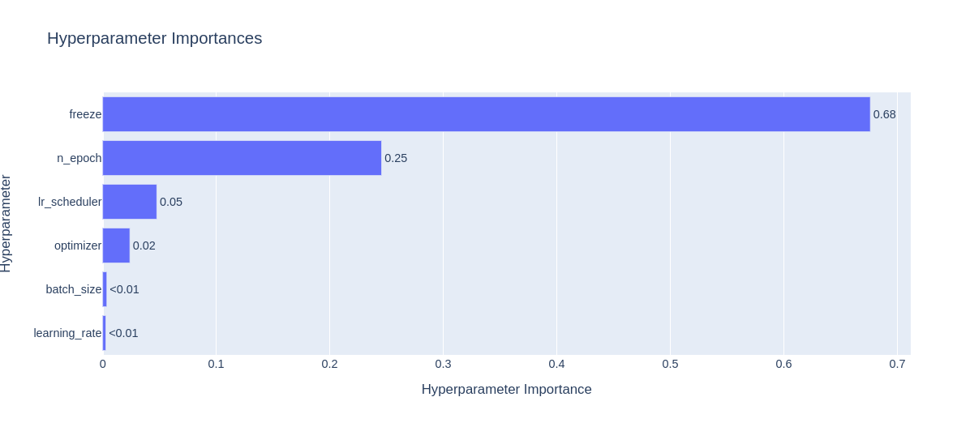
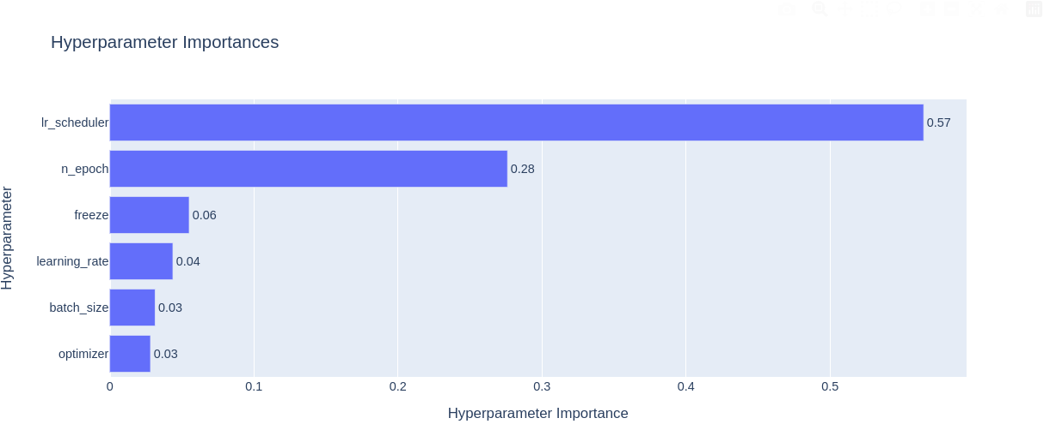
Experimental result: EDA + AutoML
EDA 0.1
EDA 0.01

Slide 21
Conclusion: performance
 | Evaluation Score (out-of-domain)
Method | F1 Score | Exact Match(EM)
Base Line | 48.41 | 31.94
Only EDA(0.1) | 47.25 | 32.20
Only EDA(0.01) | 50.03 | 35.08(+9.8%)
Only AutoML | 50.23(+3.76%) | 34.03
EDA(0.1) + AutoML | 48.97 | 34.82
EDA(0.01) + AutoML | 50.31(+3.9%) | 35.12(+9.95%)
Overall, the performance has been improved

Slide 22
Conclusion: Limitation
Sample 1: Diary of a kid
Bean wants to go to camp
Bean is too young
So Bean and her best friend, Ivy, decide to create their own camp
Story about camp
Q. Who wants to start a camp
Bean
P. Bean

Slide 23
Conclusion: Limitation
Sample 1: Diary of a kid
Bean wants to go to camp
Bean is too young
So Bean and her best friend, Ivy, decide to create their own camp
Story about camp
Q. Who wants to start a camp
Bean
P. Bean
When it's okay to understand a part of the context

Slide 24
Conclusion: Limitation
Sample 2: Deserts are found where there is little rainfall
Deserts are found where there is little rainfall
The principle by which deserts are created
The principle of the making of sand
Information about sand in the desert
Day and night in the desert
Q. What' the best title of this passage?
Desert
P. Sand begins as tiny pieces of rock that get smaller and smaller as wind and weather wear them down

Slide 25
Conclusion: Limitation
Sample 2: Deserts are found where there is little rainfall
Deserts are found where there is little rainfall
The principle by which deserts are created
The principle of the making of sand
Information about sand in the desert
Day and night in the desert
Q. What' the best title of this passage?
Desert
P. Sand begins as tiny pieces of rock that get smaller and smaller as wind and weather wear them down
When model needs to understand the entire context

Slide 26
Thank you.

